Slide 1
Mandana
10 Introduction / dtu research, student work
Visual comfort
20 Shadings
5 radiance
- Mentioning spectralDB
Mathias
10 min intro + slides
20 min recap from NLITED 5.1 (applying it on the Office building)
Break + installation
40-45 “workshop” with climatestudio
Custom materials from spectralDB
Ground material

Slide 2
NLITED Summer school #2
Gdansk
2023-08-31
Lecture
Hands on simulations
Teacher: Mathias Sønderskov Schaltz, LINK Arkitektur, Denmark
Notes:
https://www.radiance-online.org/learning/tutorials/matrix-based-methods
https://www.radiance-online.org/learning/tutorials

Slide 3
2014-2021: Henning Larsen Architects
2014 - Introduced to DIVA3 and Reinhart’s books
2015 - Introduced to Ladybug Tools
2017 - Scratching the surface of Radiance
2018 - Attended first RW in Loughborough
2019-2020: Uppsala Town Hall, Façade and Glass Roof
2018 - Learning C# and Python coding
2019 - Censored first master thesis projects
2021- present : LINK Arkitektur
2021 - Developed MantaRay plugin for Rhino/Grasshopper
2021 - Supervised first master thesis project
2021 - Recording NLited webinars
2022 - Presenting MantaRay at the RW.
Resume
Mathias Sønderskov Schalts

Slide 4
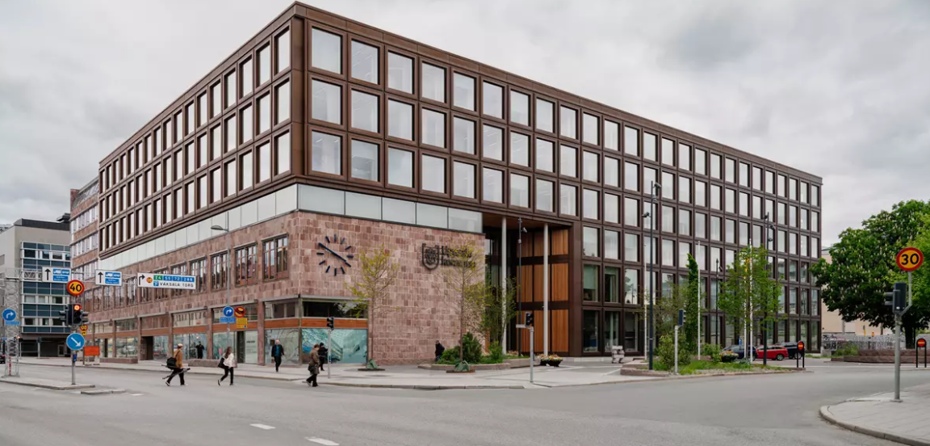
Lets set the mood with Uppsala Town Hall

Slide 5
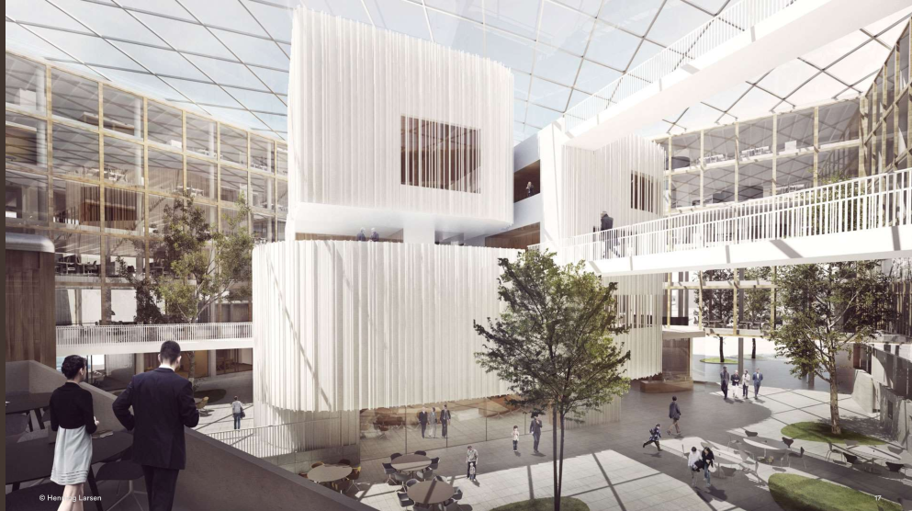
Lets set the mood with Uppsala Town Hall

Slide 6
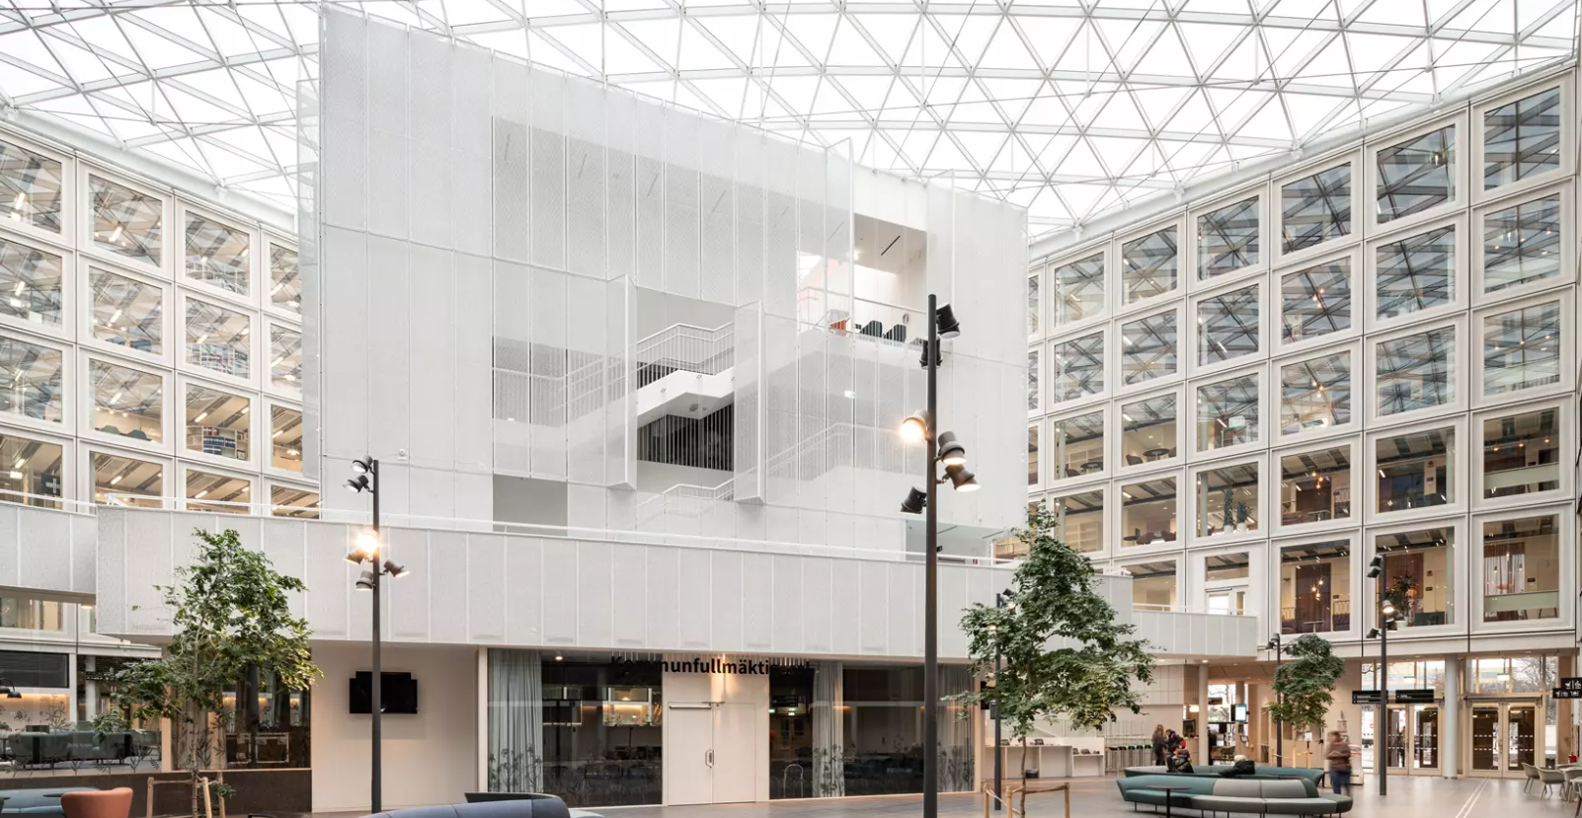

Slide 7
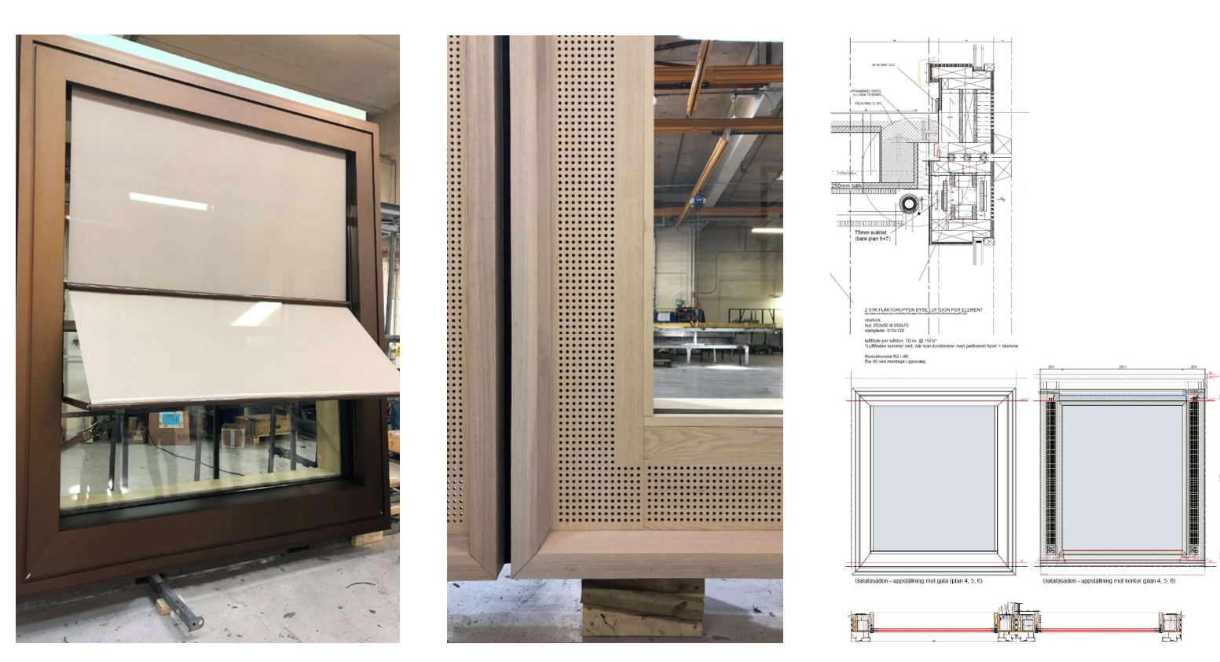

Slide 8
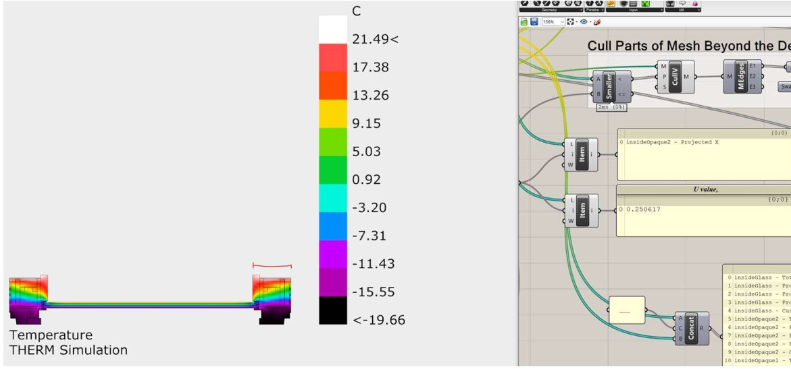

Slide 9
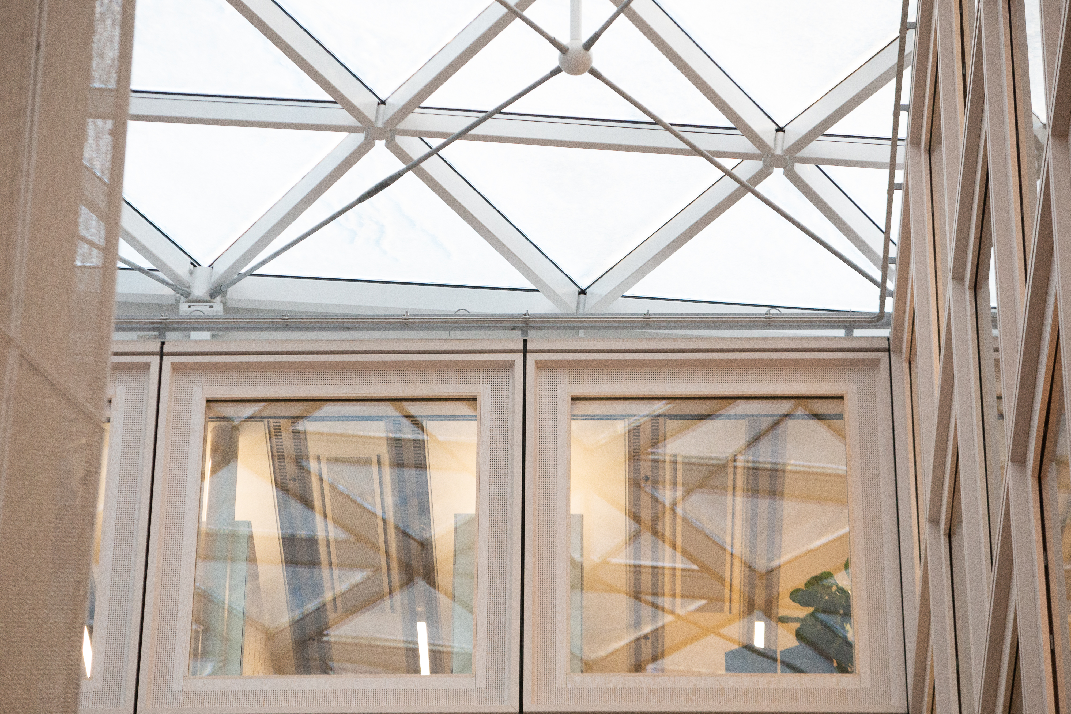
Uppsala Town Hall

Slide 10
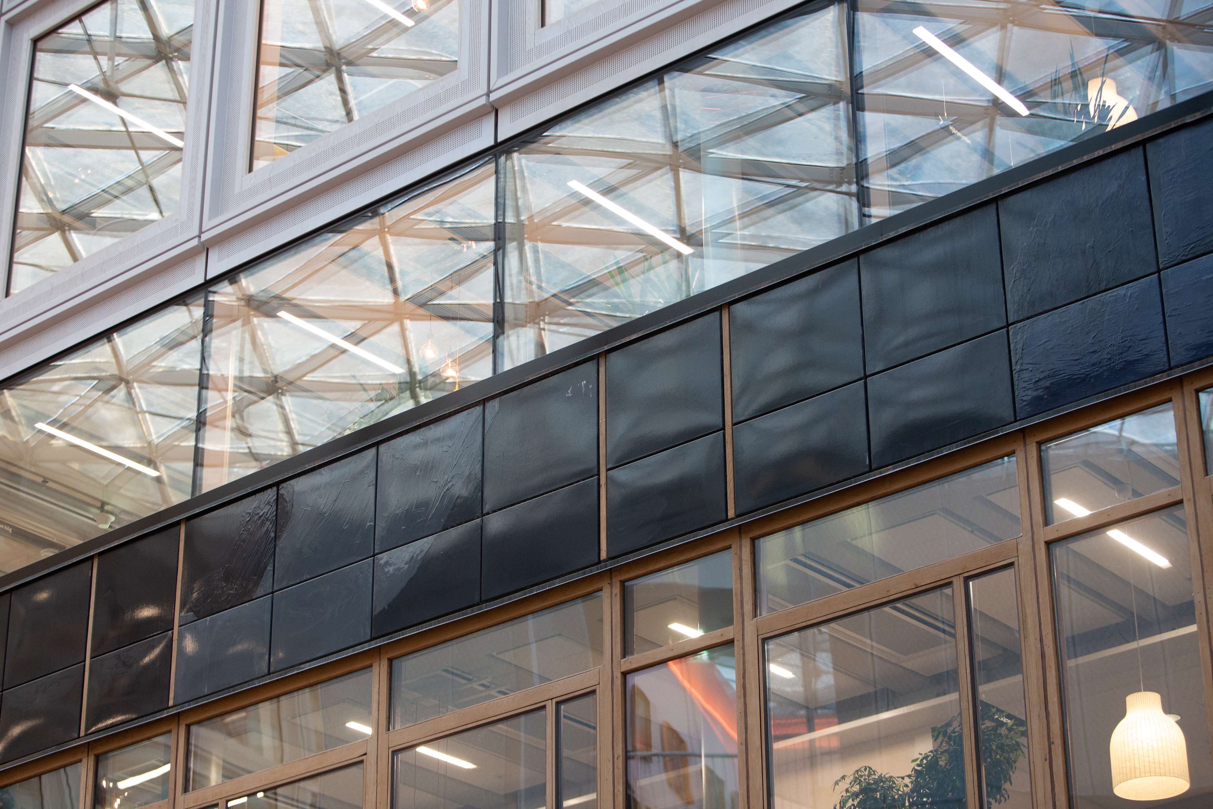
Uppsala Town Hall

Slide 11
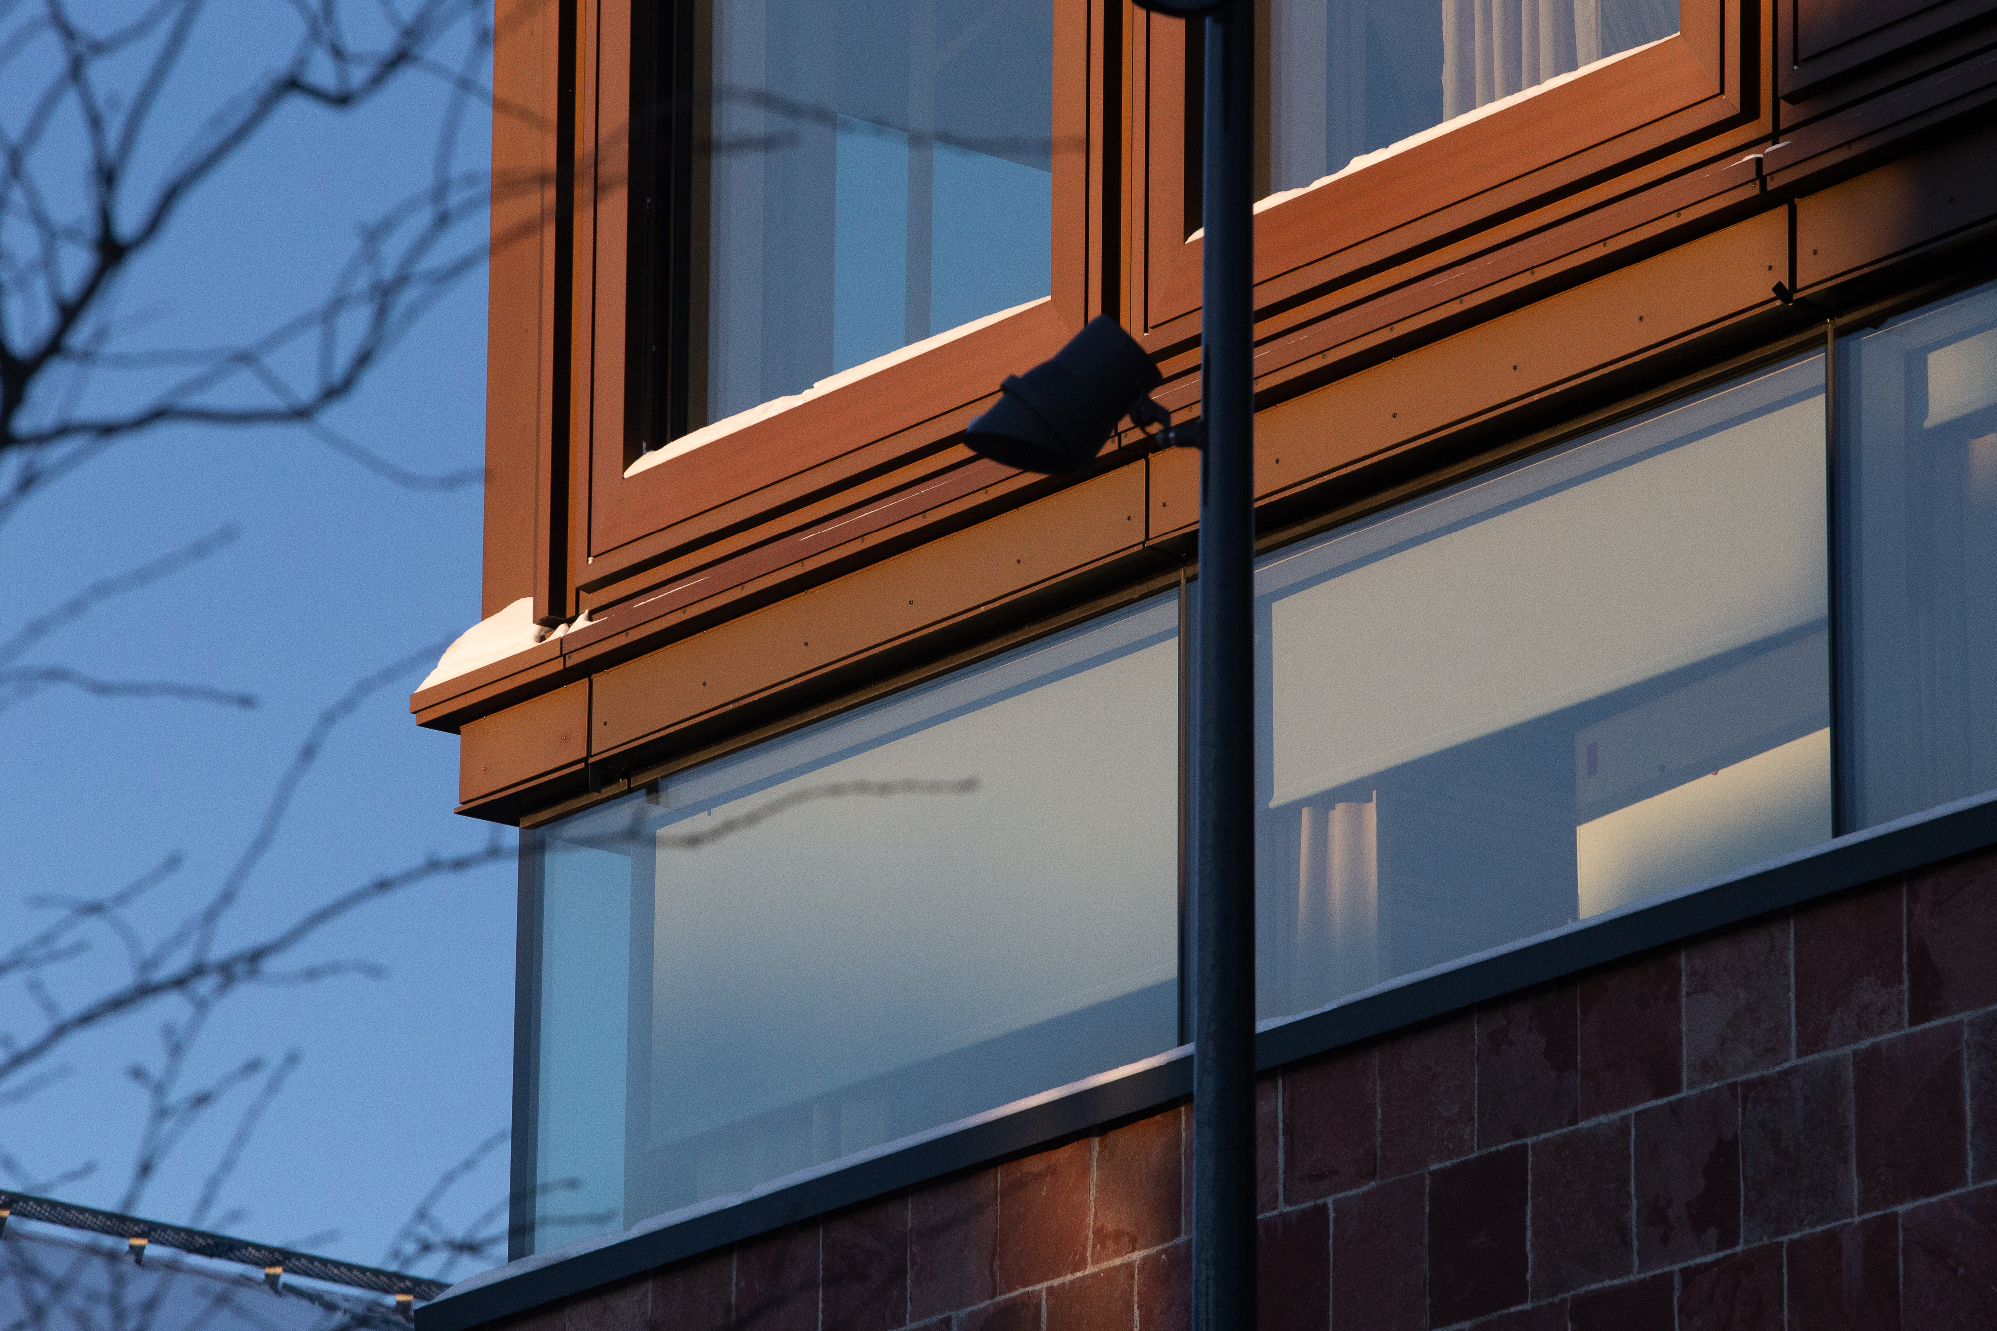
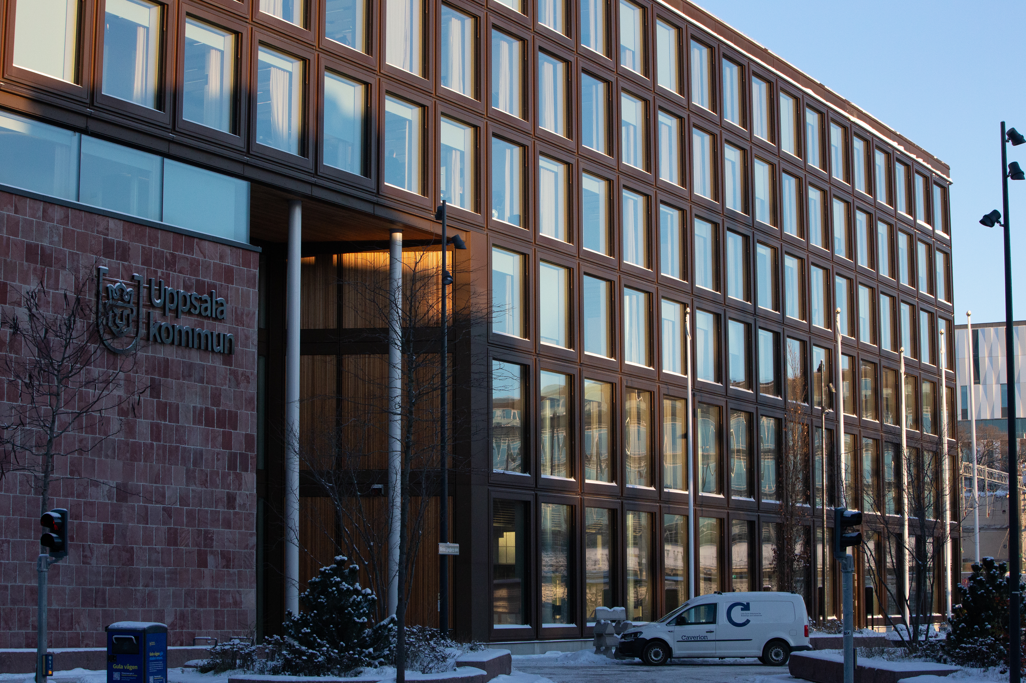
Uppsala Town Hall

Slide 12
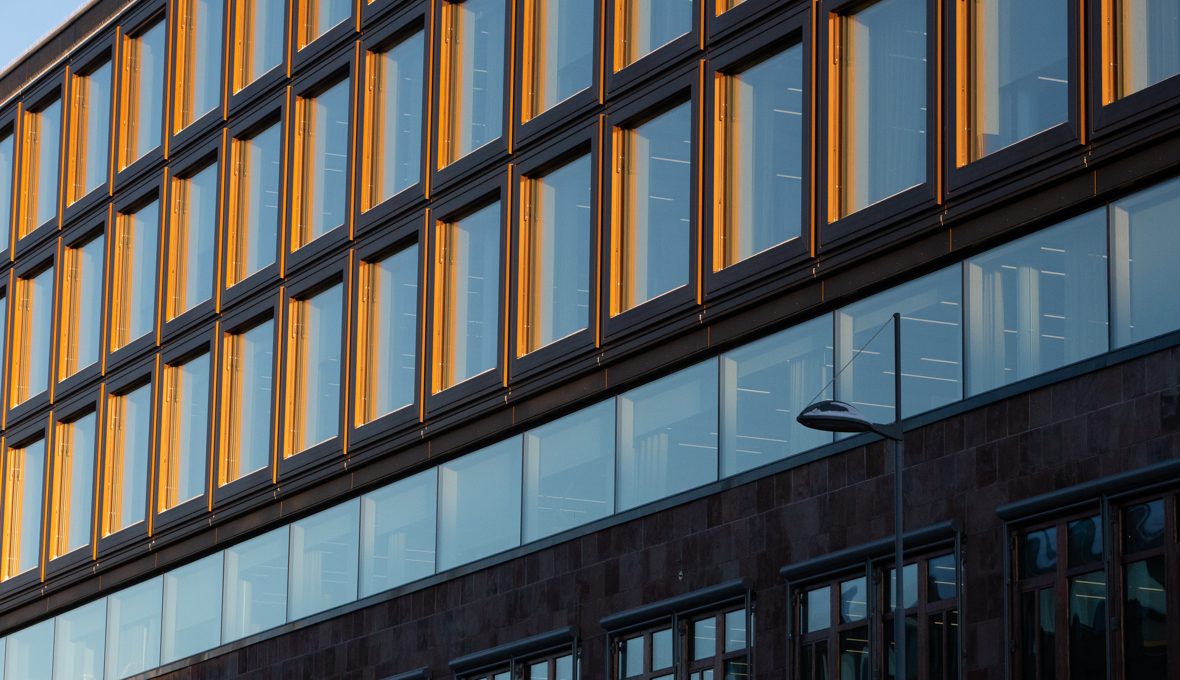
Uppsala Town Hall

Slide 13
Computational Ideas, Daylighting

Slide 14
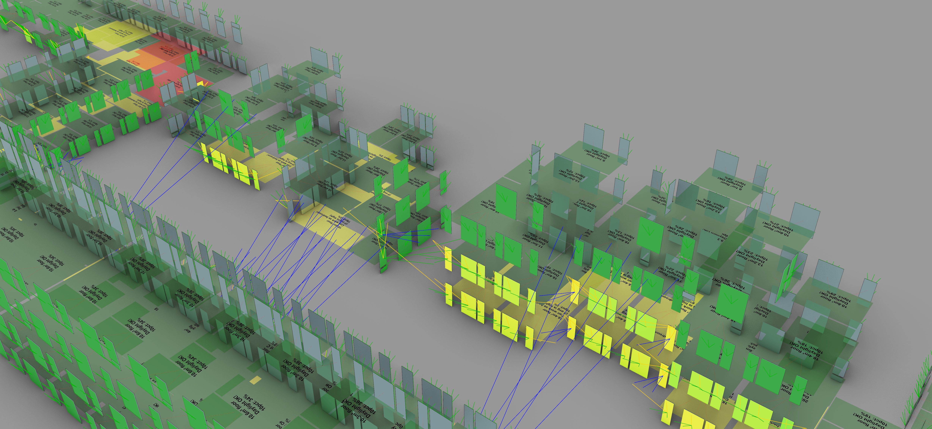
Notes

Slide 15
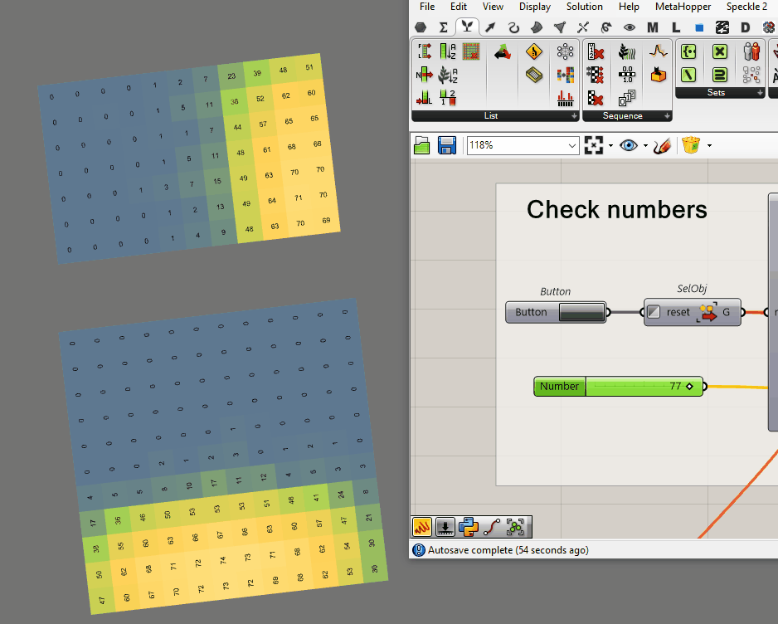
Notes
Calculating backwards to find “efficient zone”

Slide 16
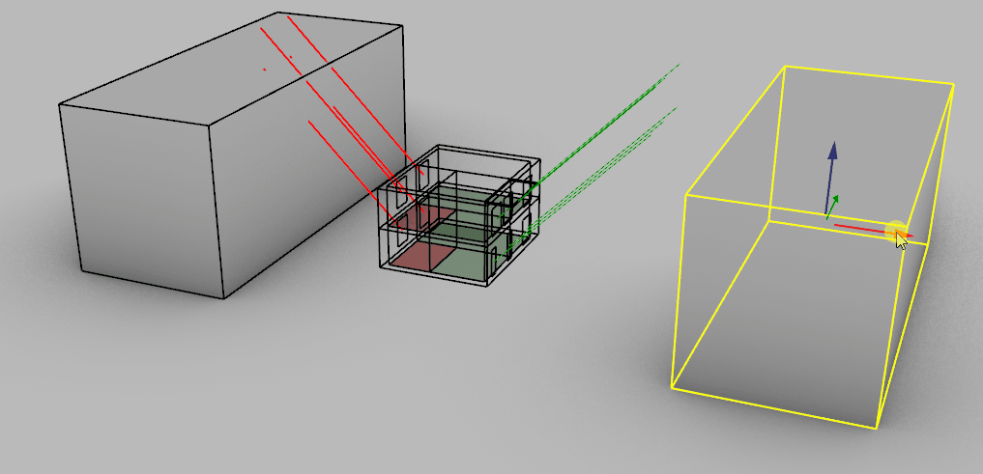
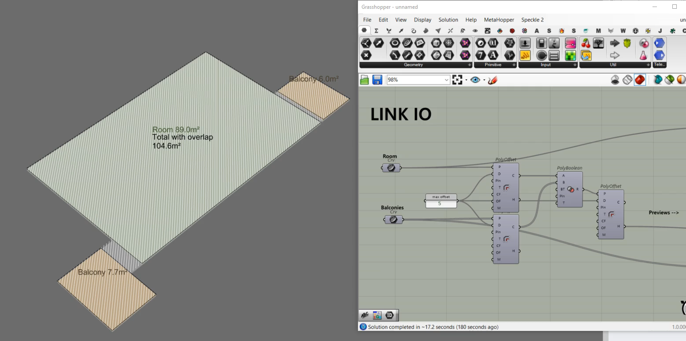
Notes
Norwegian “rule of thumb”

Slide 17
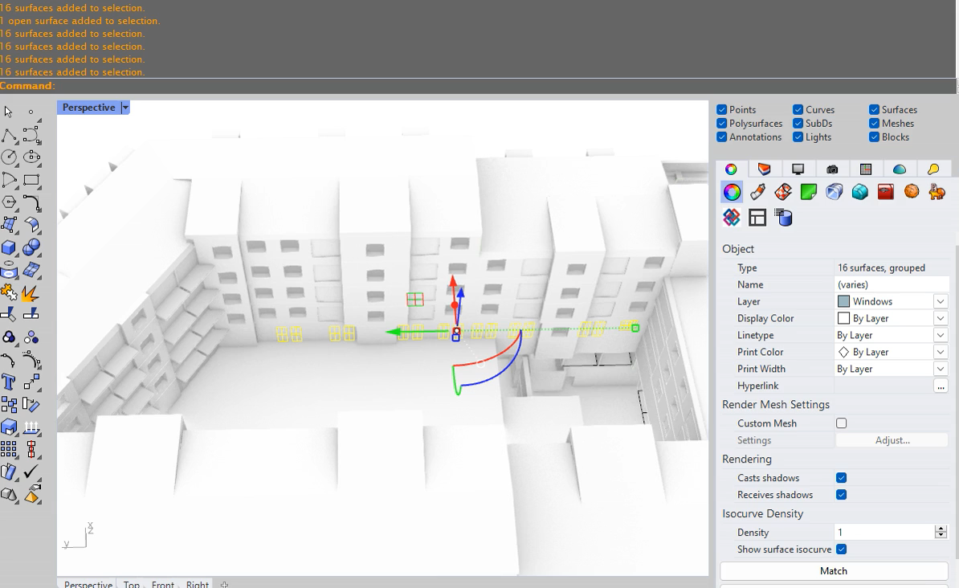
Notes

Slide 18
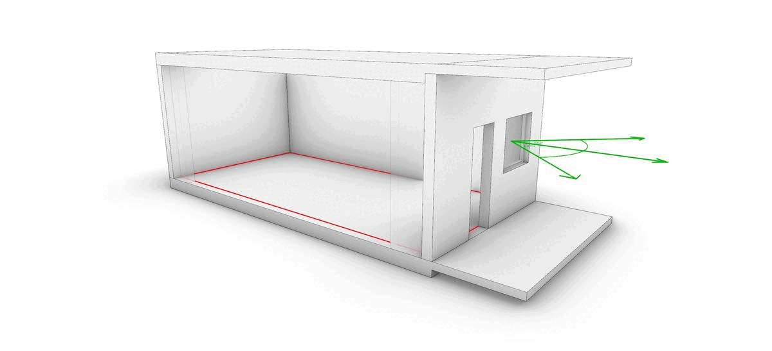
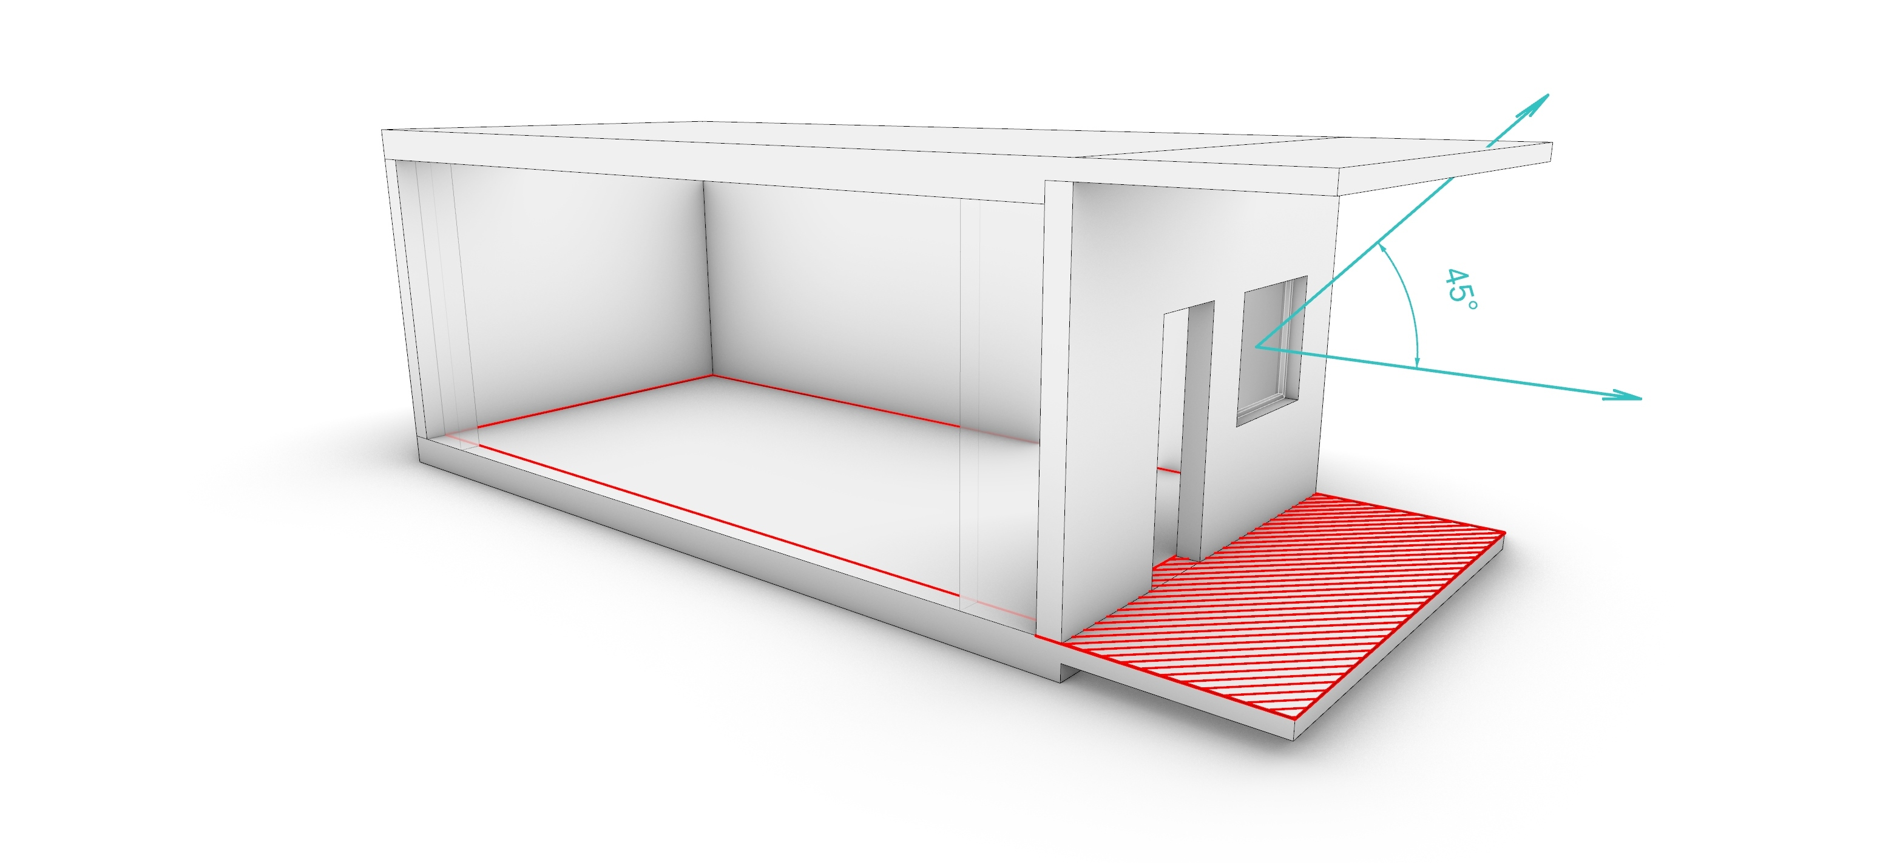
Notes
10% Daylight rule in Denmark with 10 factors
Balconies are checked for collision
10% Daylight rule in Norway with one factor
Balconies are included in floor area

Slide 19
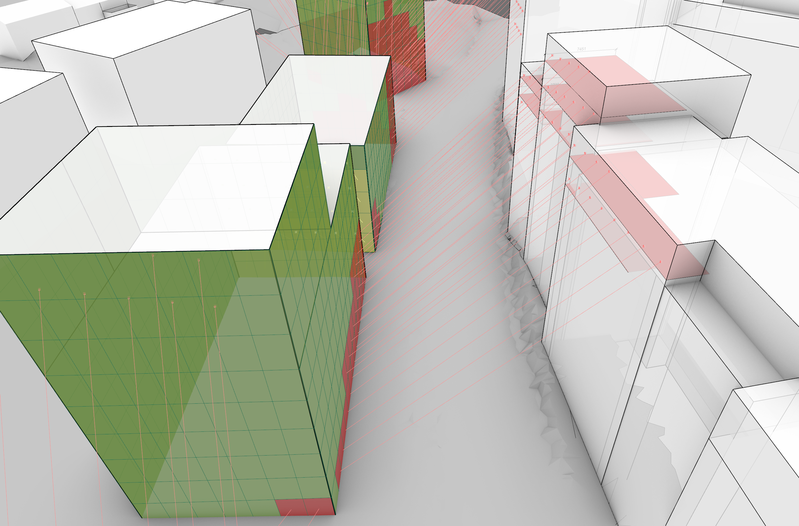
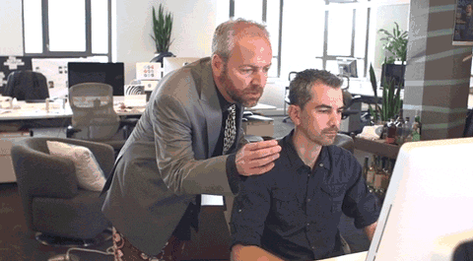
Notes
-184m²
LINK_EP
-152m²
Architect
Existing
Proposed

Slide 20
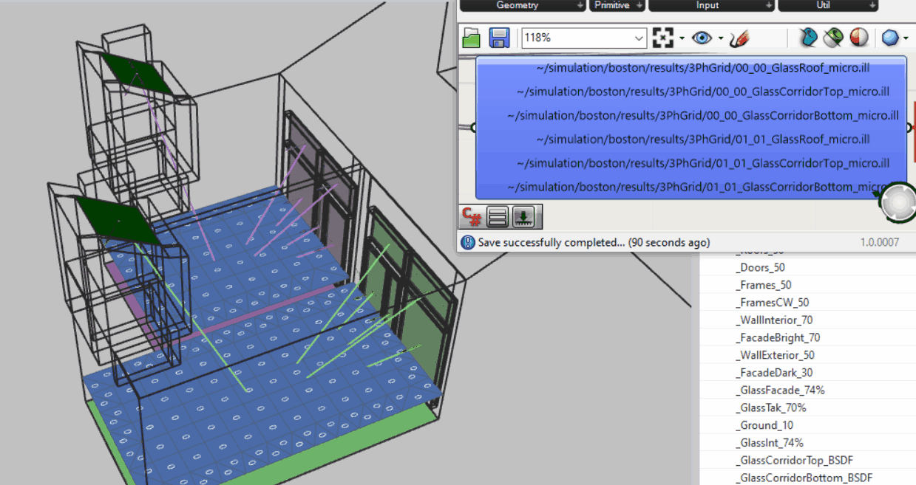
Notes
Multiphase simulations allow you to changeglass types and turn apertures on/off in postprocessing!

Slide 21
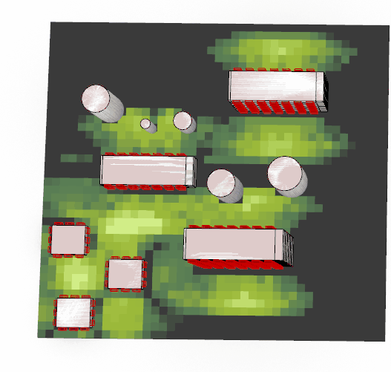
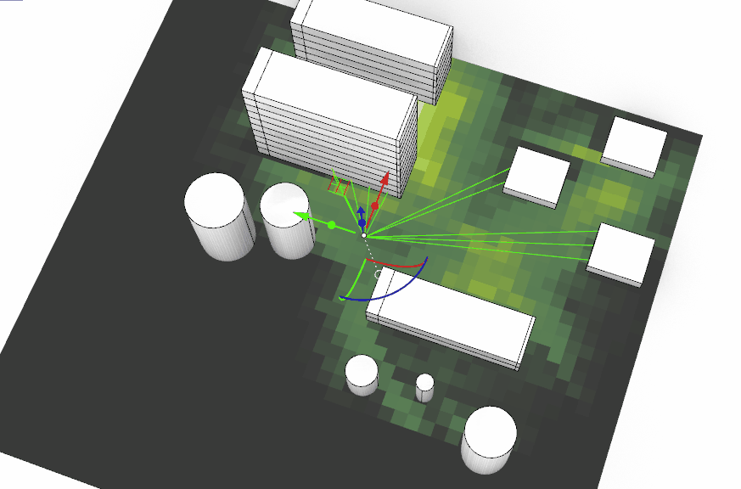
Notes
“Safety” simulations – view from apartments

Slide 22
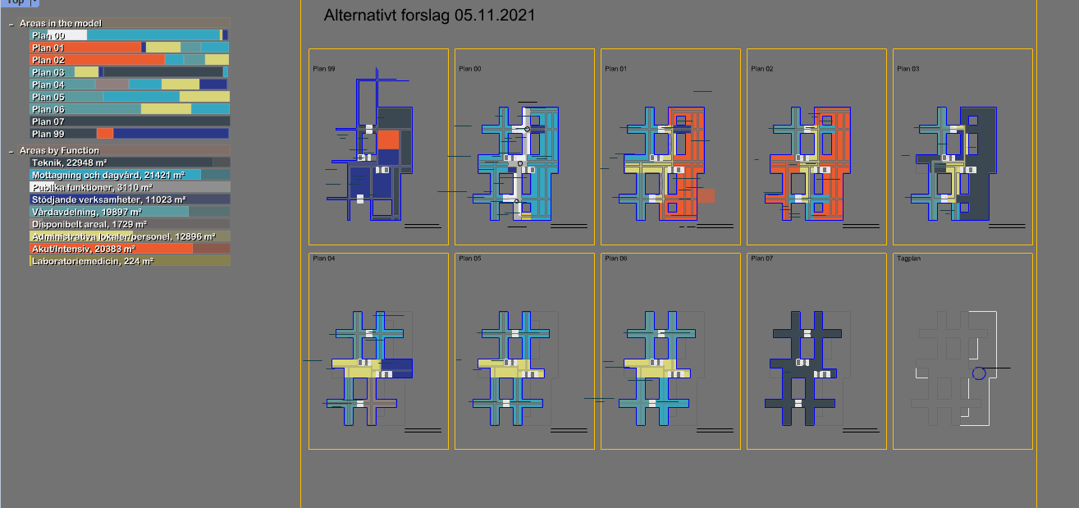
Notes
LINK Dashboards (free on Food4Rhino)

Slide 23
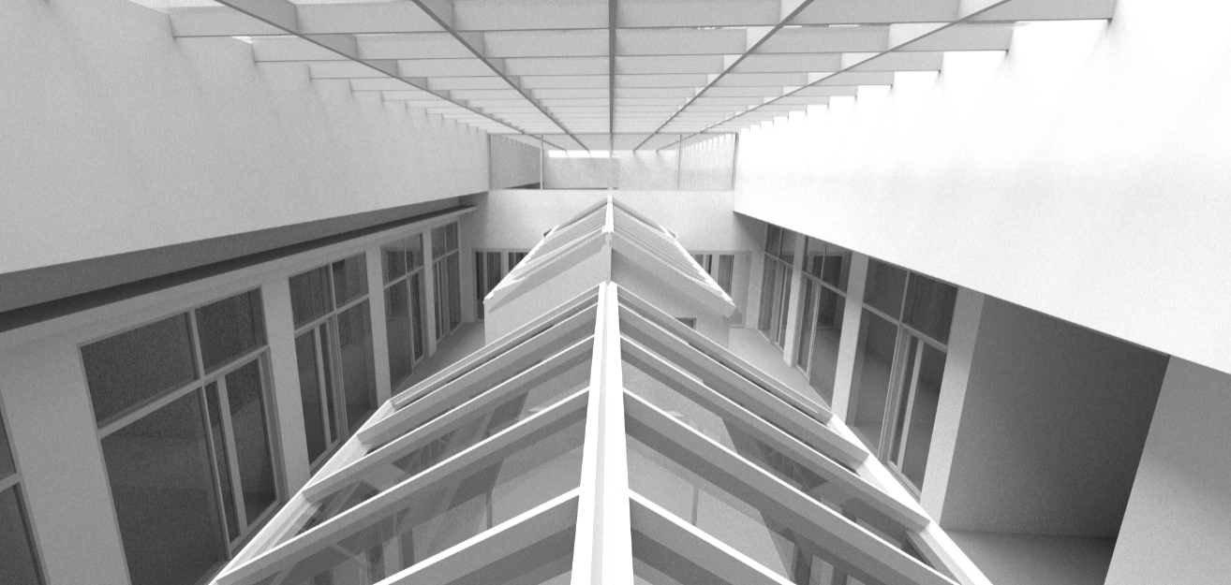
Computational Ideas X Daylighting
Designing 4000 rooms…

Slide 24
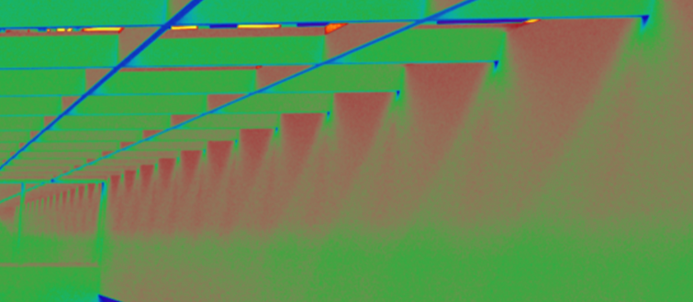
Thanks for the reminder, Paul!
Computational Ideas X Daylighting
Designing 4000 rooms…

Slide 25
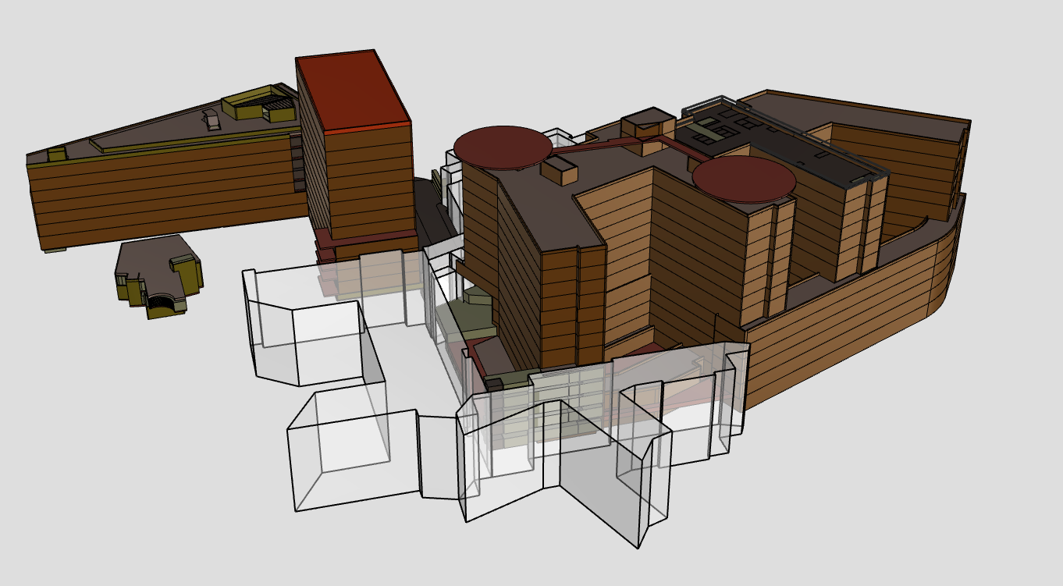
Case: Rikshospitalet – Get envelope with Rhino Inside Revit
LINK Arkitektur / LINK IO / Dagslysanalyser
Calculating daylight with no windows
25

Slide 26
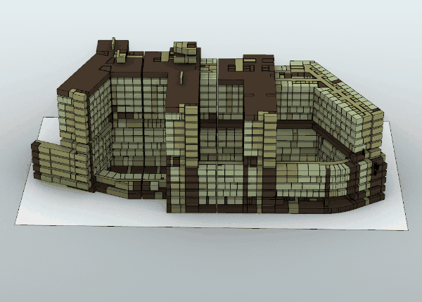
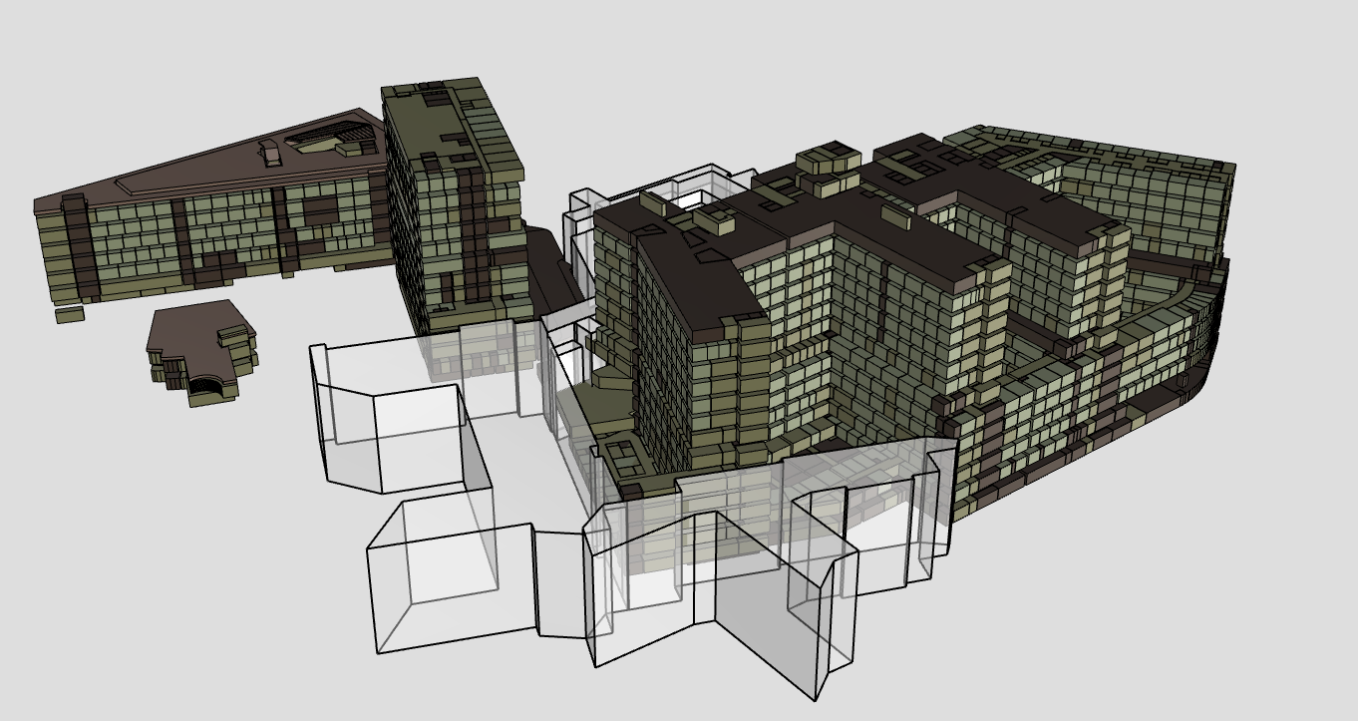
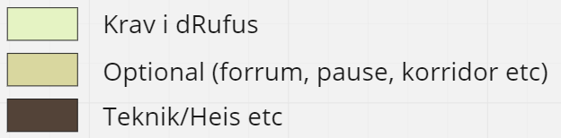
Case: Rikshospitalet – Get rooms with Rhino Inside Revit – filter by daylight req
LINK Arkitektur / LINK IO / Dagslysanalyser
26

Slide 27
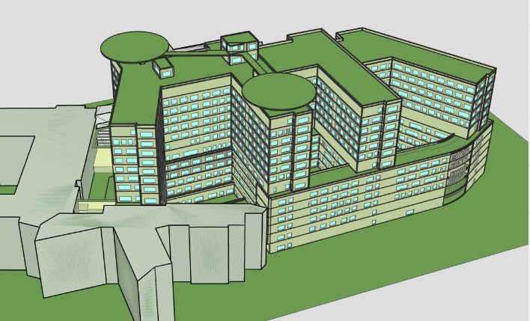
Case: Rikshospitalet – Create generic windows to measure VSC (or VDF)
LINK Arkitektur / LINK IO / Dagslysanalyser
27

Slide 28
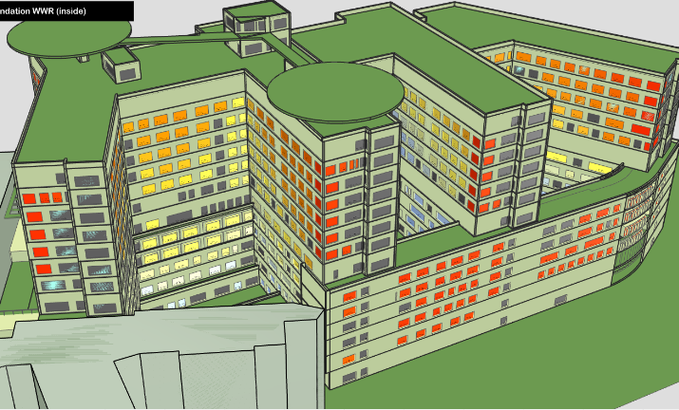
Case: Rikshospitalet – Measure VSC (or Vertical Daylight Factor)
LINK Arkitektur / LINK IO / Dagslysanalyser
VDF in each window
28

Slide 29
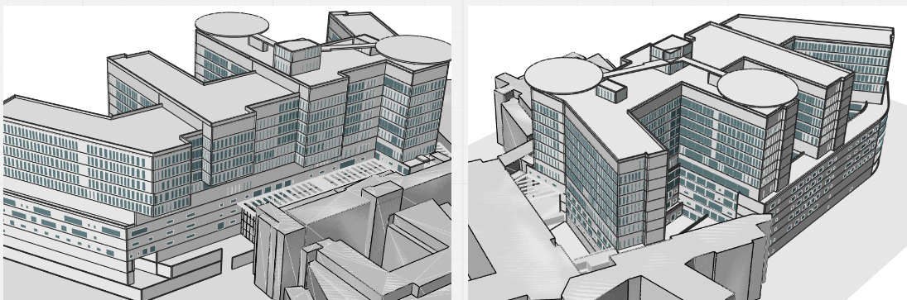
Case: Rikshospitalet – «Pseudo model» for engineers and facade designers
LINK Arkitektur / LINK IO / Dagslysanalyser
A diagram for the façade designer
29

Slide 30
Case: Rikshospitalet – Inform facade design by VSC
Room daylight requirement (dRufus)
Repeat untill
satisfied
Room depth
Rule of thumb Window-To-Wall-Ratio (WWR)
Simulate average DF on floor
Adjust WWR up/down
LINK Arkitektur / LINK IO / Dagslysanalyser
Simulate average DF on floor
Room width
Room façade area
Vertical Daylight Factor on window
30

Slide 31
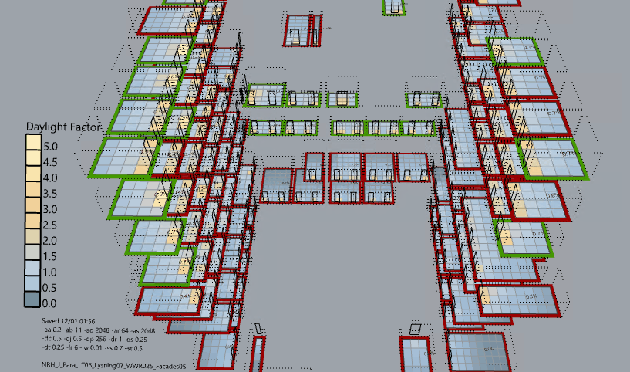
LINK Arkitektur / LINK IO / Dagslysanalyser
31

Slide 32
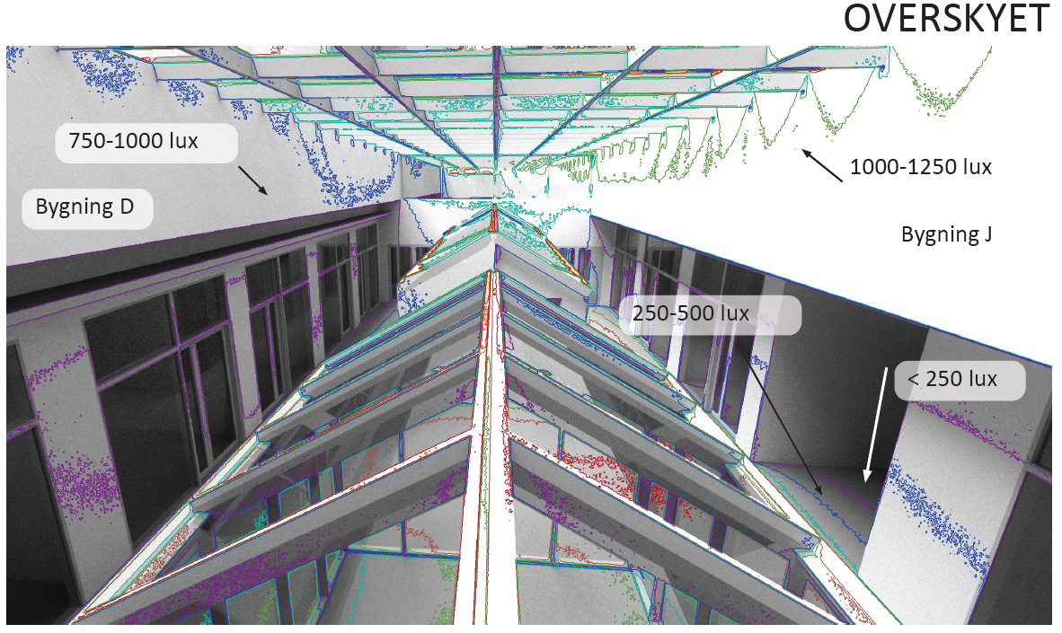
Case: Rikshospitalet
LINK Arkitektur / LINK IO / Dagslysanalyser
32

Slide 33
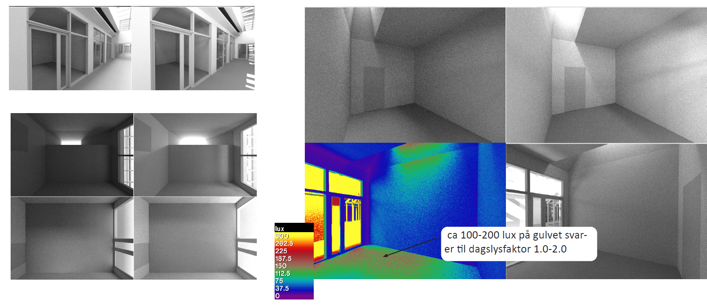
Case: Rikshospitalet
LINK Arkitektur / LINK IO / Dagslysanalyser
33

Slide 34
Outcome of todays workshop
Hands on experimenting with different simulation tools
“Simulation based Experimentation”
Summary of content from NLITED 5.1 online (20 m) Walk through of our LadybugTools (LBT) workflow in Grasshopper
Break
Introduction to Climate Studio (CS) in Rhino (45 m) And easy conversions from LBT models to CS.

Slide 35
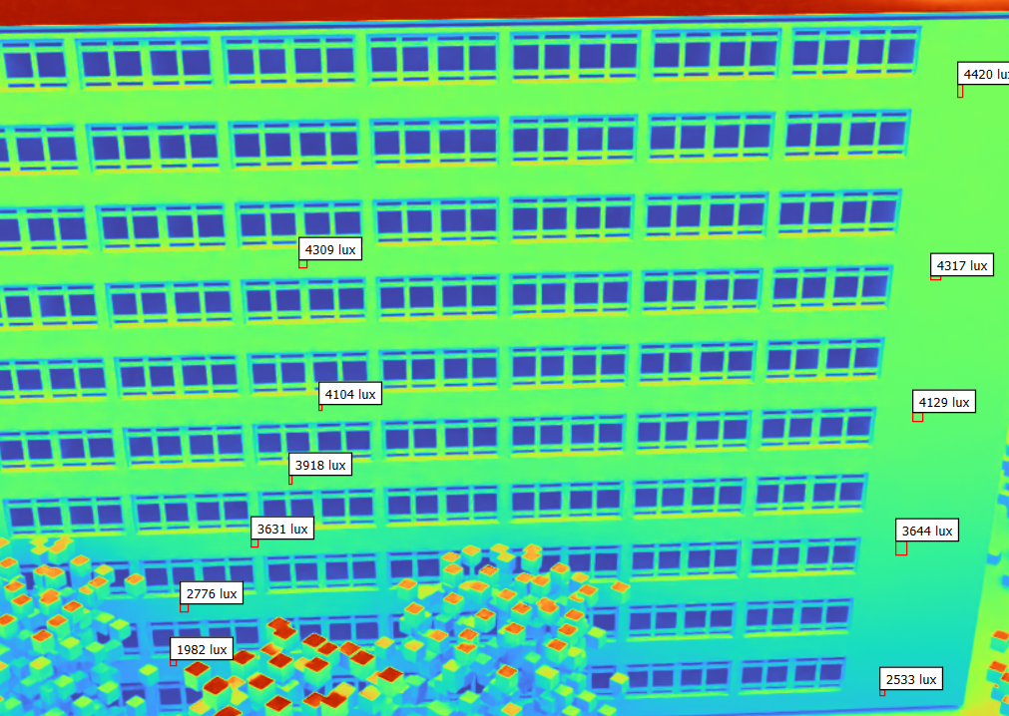
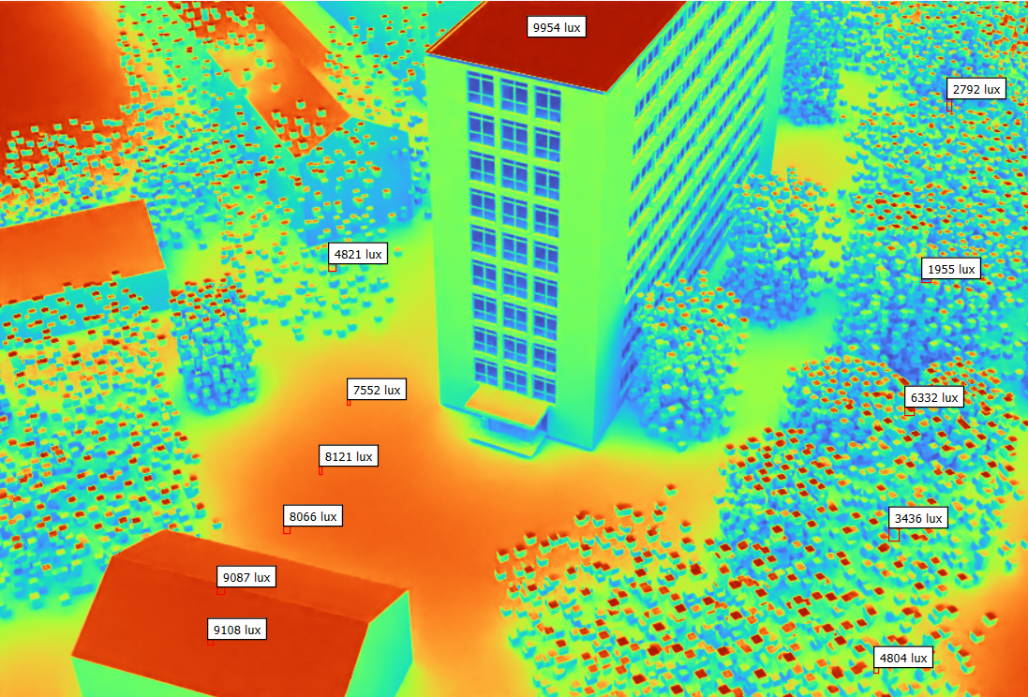
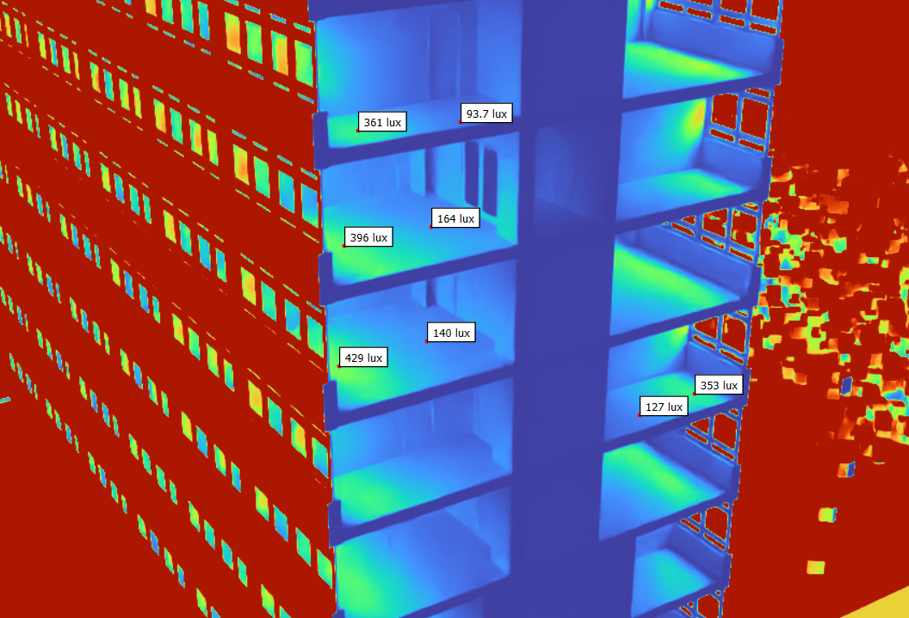
Outcome of todays workshop
Hands on experimenting with different simulation tools
Point in time with a 10klux overcast sky ->Vertical daylight factor

Slide 36
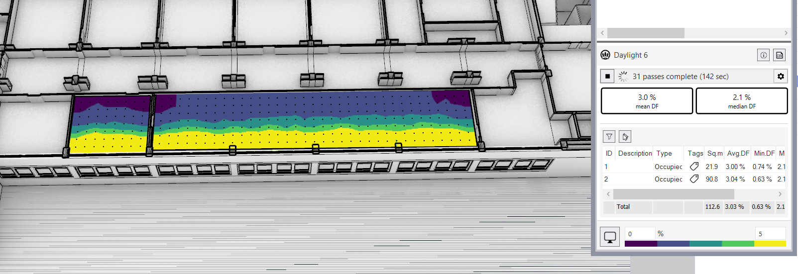
Outcome of todays workshop
Hands on experimenting with different simulation tools

Slide 37
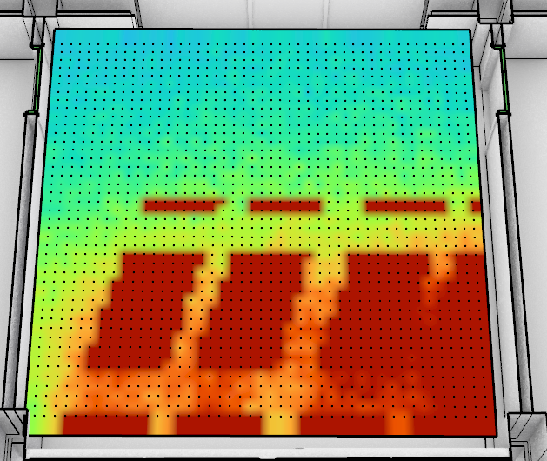
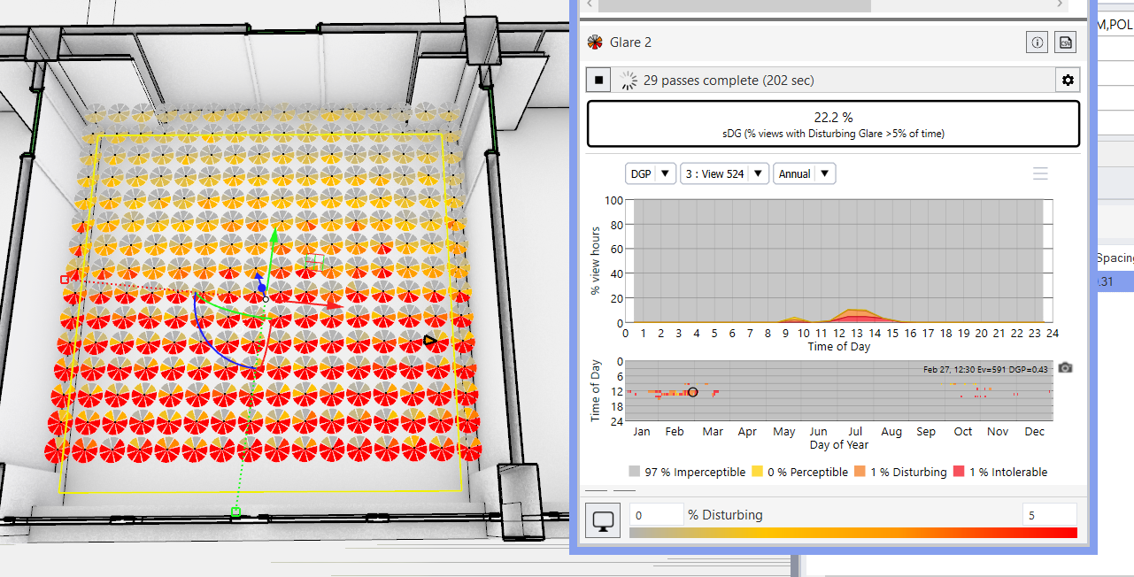
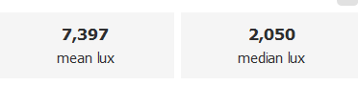
Outcome of todays workshop
Hands on experimenting with different simulation tools

Slide 38
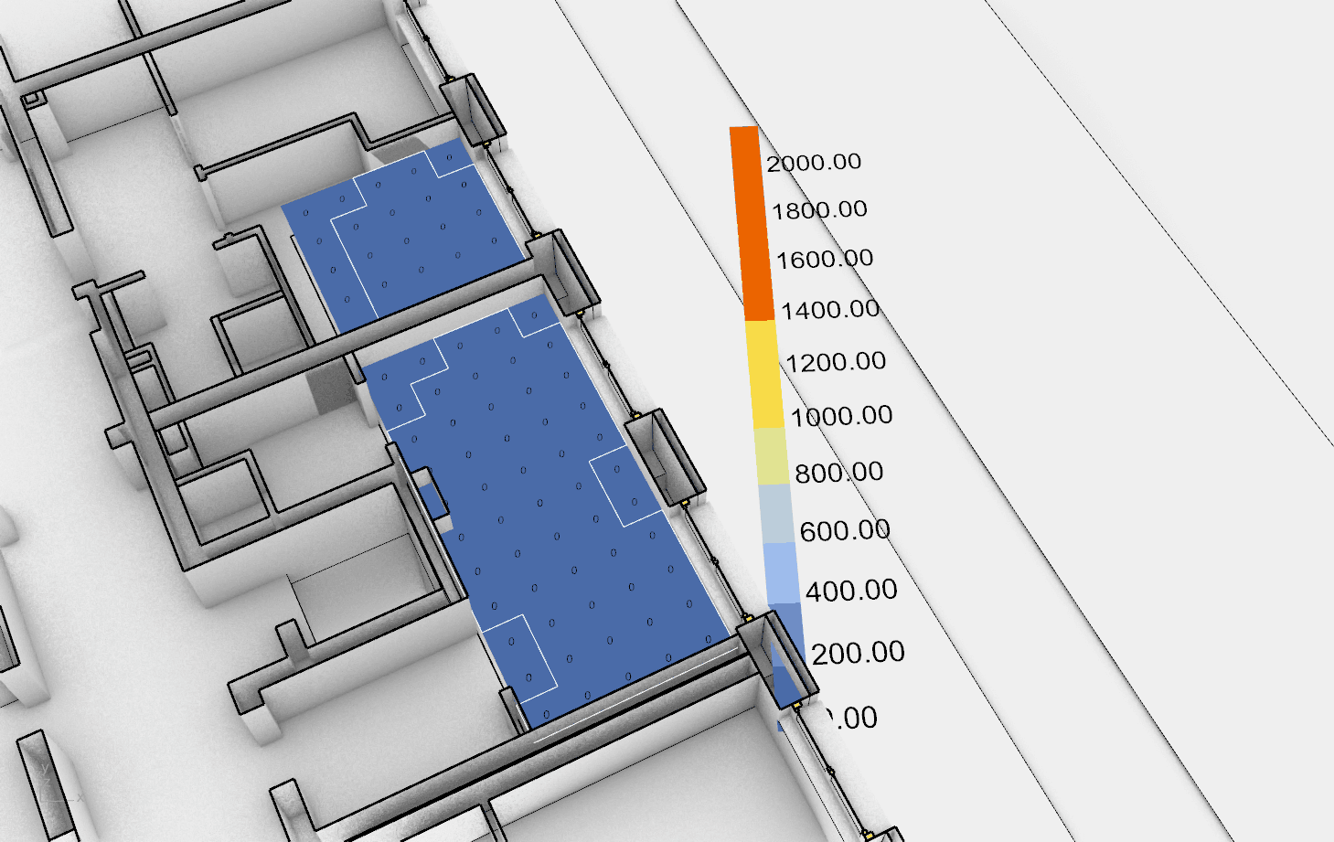
Outcome of todays workshop
Hands on experimenting with different simulation tools

Slide 39
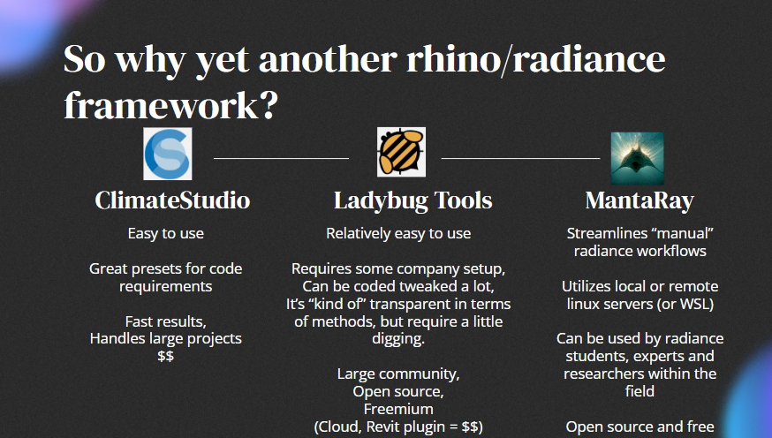
Daylighting tools in Rhino

Slide 40
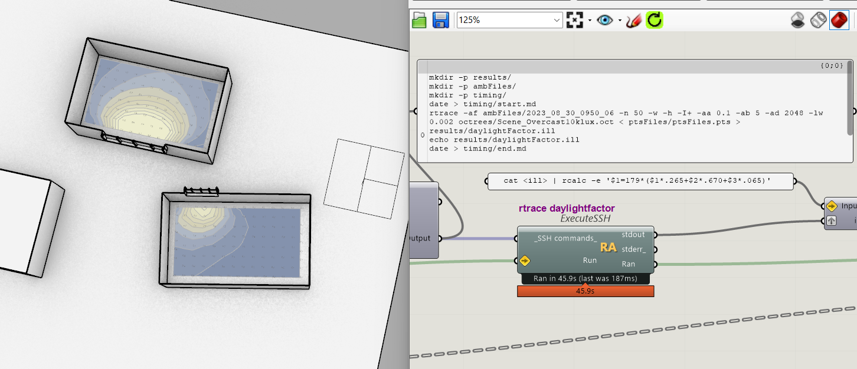
Daylighting tools in Rhino

Slide 41
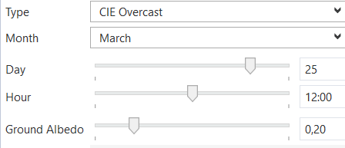
Notes

Slide 42
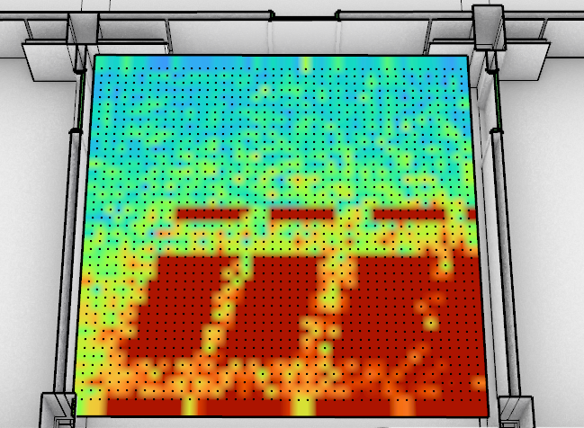
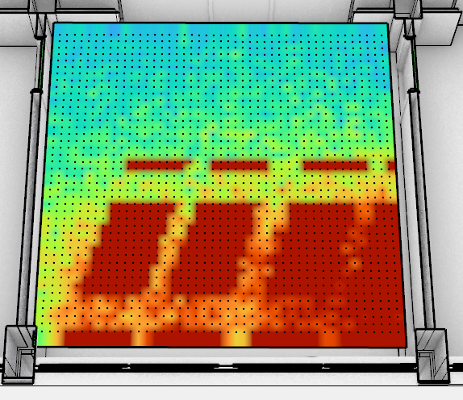
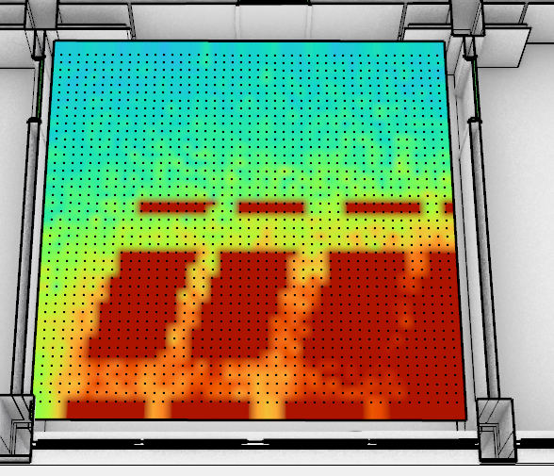
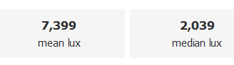

Notes
1 pass (15s)
6 pass (90s)
15 pass (200 s)
30 pass (300 s)
ClimateStudio “passes” is awesome:
Whats the KPI? Watch for convergence

Slide 43

Notes
2cd/m2
0.7cd/m2
5,5cd/m2
3.2cd/m2
+ 200% luminances, just from opposing facade

Slide 44

Notes

Slide 45

Notes

Slide 46

Notes

Slide 47
Live demo – Recap grasshopper from NLITED 5.2

Slide 48

Break

Slide 49
Live demo – Climate Studio in Rhino

Slide 50





Acknowledgements
This lecture was produced within the NLITED project co-funded by the Erasmus+ Programme of the European Union.
New Level of Integrated Techniques for Daylighting education Project Ref: 2020-1-IT02-KA203-079527
Credits
All content was provided by the teachers.
Disclaimer
The sole responsibility for the content published on this module lies with the authors. It does not necessarily reflect the opinion of the NLITED Consortium or the European Union (EU). NLITED and the EU are not responsible for any use that may be made of the information contained therein.
Copyright
CC BY-NC-ND 4.0
This work is licensed under a Creative Commons Attribution-NonCommercial-NoDerivatives 4.0 International.
To view a copy of this license, visit https://creativecommons.org/licenses/by-nc-nd/4.0/
PROJECT REF 2020-1-IT02-KA203-079527

